Slide 1
Case Study - Spotify
Kishen Saravanan
Raghavendran Shankar
Rajasekar Kamaraj

Slide 2
Introduction
The successfulness of the song is determined by various audio features which makes it to go up the ladder in the Top Billboard charts

Slide 3
Objective
To predict the successfulness of the a particular song
Analyzing the audio features of the song
Audio features include
Danceability level
Energy
Tempo
Valence
Acousticness
Liveliness
Loudness

Slide 4
Given data set
Data includes songs from Billboard’s charts from Jan 1, 2000 – Dec 31, 2005

Slide 5
Spotify API configuration
Establish a connection between R and Spotify for analysis
Key configurations
Client key
Client Secret Key
Request and Response URL
Authentication Key – 0auth token
Spotify Playlist ID
Spotify User ID

Slide 6
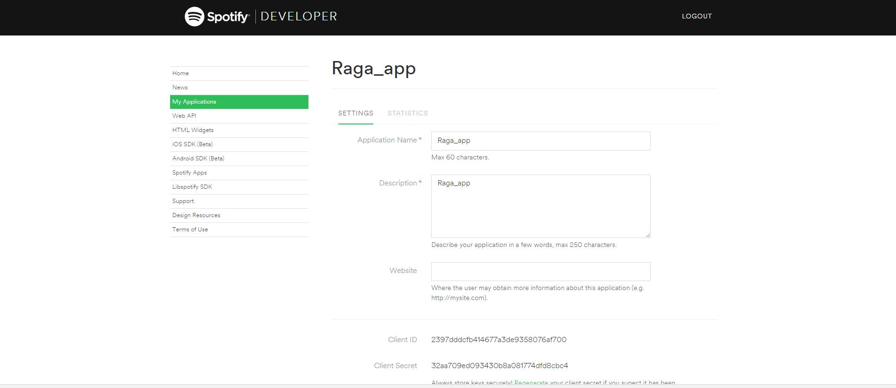
Spotify App

Slide 7

Spotify User ID

Slide 8

Spotify Playlist

Slide 9
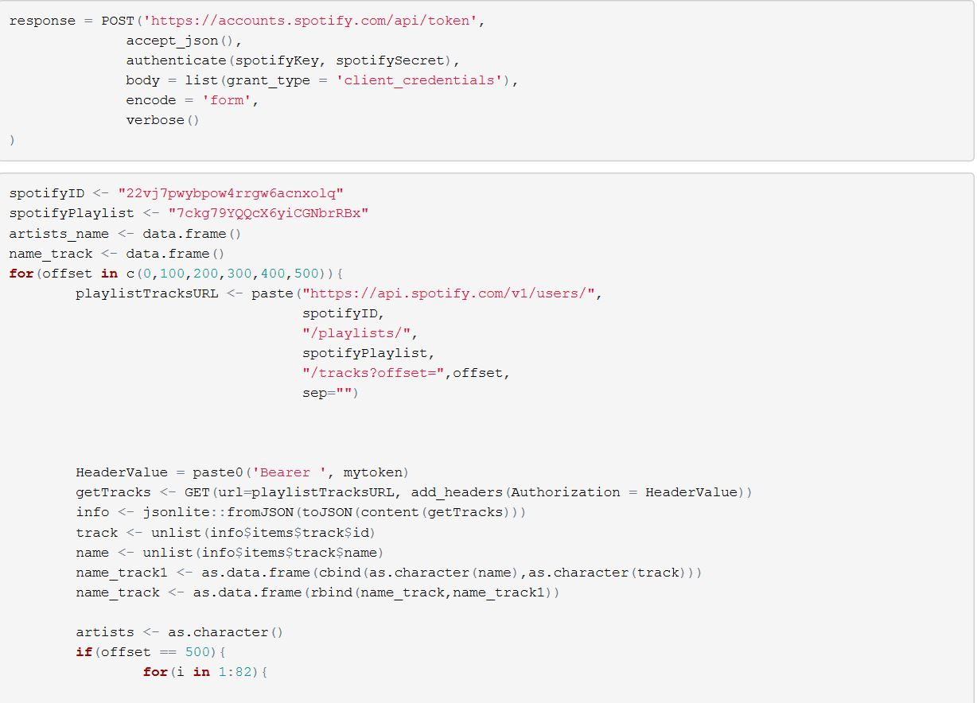
Getting Song names and artists

Slide 10
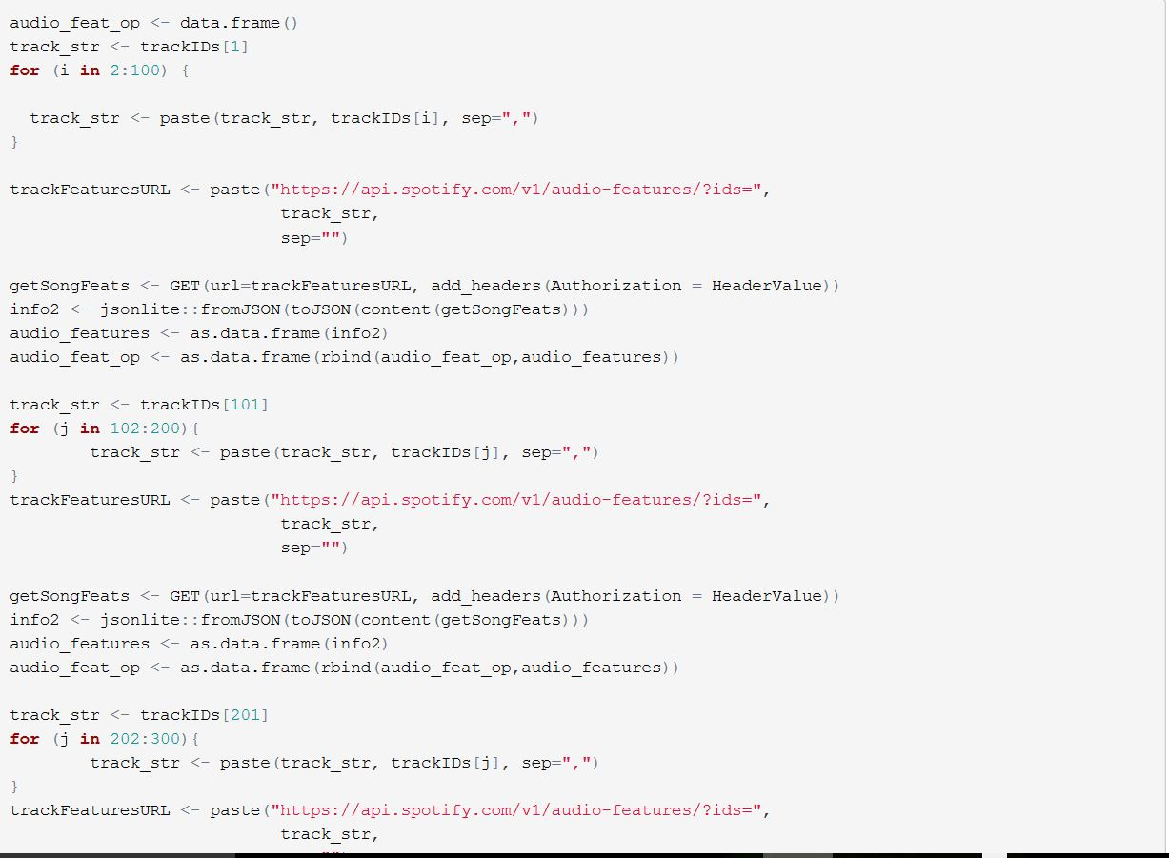
Spotify Track IDs

Slide 11
Data Cleaning
Imported from Spotify
Duplicates were removed
Missing songs were removed from the song list
Merging songs
Song file and songs from Spotify were merged with ‘Artist name’ and ‘Title’ as key.
Used special packages such as ‘stringdist’ to merge the song list and song features by joins.
Used special functions such as ‘gsub’ to remove punctuations in the song title for effective merging.

Slide 12
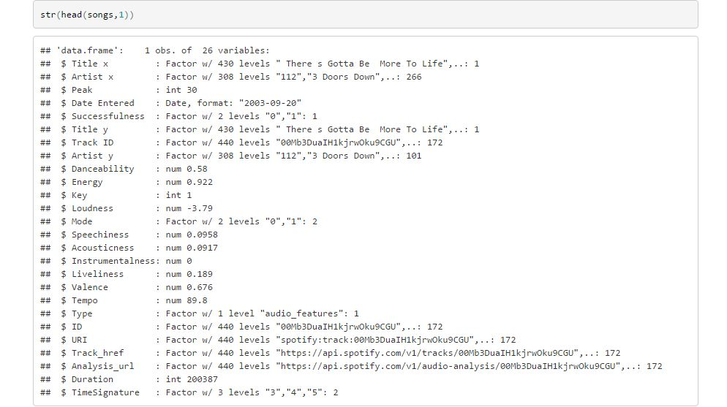
Structure of data
The structure of the songs data can be analyzed by using the str() function which displays the classes of each column.
With str() function we can segregate the data into numerical and categorical data

Slide 13
Prediction of successfulness of songs
The successfulness of the songs can be predicted as supervised learning i.e classification and regression
Classification
0 denotes unsuccessfulness
1 denotes successfulness
One part of the song dataset is trained and the other part of the data set acts as test dataset.
Prediction of successful and unsuccessful songs are made by using cross validation

Slide 14
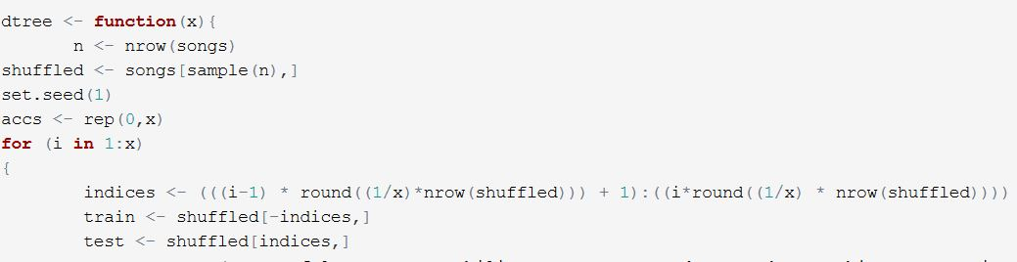
Cross Validation
Dataset is shuffled and split as training and test dataset without overlapping
10 fold cross validation is used where training and test datasets are iterated and split 10 times without repetition
For each model, accuracies are calculated 10 times and mean of accuracies is found

Slide 15
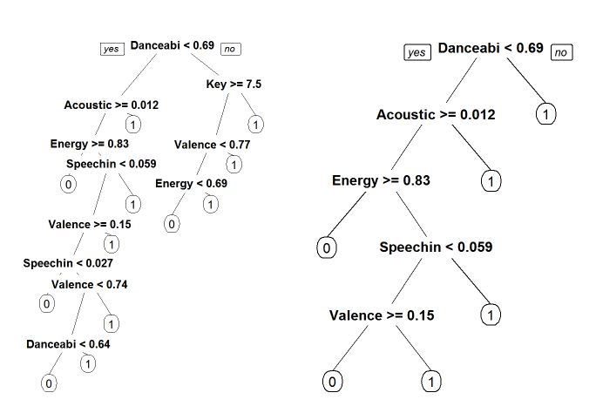
Decision Tree
Data partitioning according to class
Uses recursive partitioning function
Decision is done at the root note from which it branches to YES (left) or NO (Right)
Implementation of cross validation

Slide 16
Prediction and Accuracy in Decision tree
tree <- rpart(Successfulness ~ Danceability+Energy+Key+Loudness+Mode+Speechiness+Acousticness+Instrumentalness+Liveliness+Valence+Tempo+Duration+TimeSignature, train, method = "class")
conf <- table(test$Successfulness,pred)
accs[i] <- sum(diag(conf))/sum(conf)
Mean of accuracy in Decision tree is 0.68

Slide 17
Overfitting the data
To avoid overfitting the data, data pruning is done which ignores unnecessary splits in subsequent leaf nodes and displays the pruned decision tree
Pruning also reduces cross validation errors

Slide 18
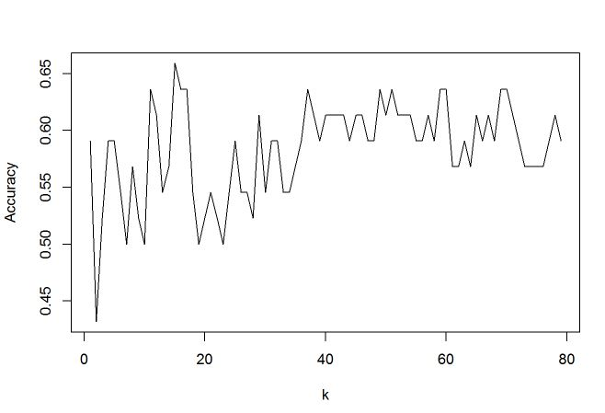
K Nearest Neighbors (KNN)
Euclidian's distance formula is used to measure K value
K value is used to classify the data into successful and unsuccessful
Cross validation is used here

Slide 19
Scaling
One of the factors that affects the accuracy of KNN is scaling. All the predictors must have the same scale to minimize the errors
The audio features like Tempo are normalized to fit the scale. Normalization formula is
(X – min(x))/max(X)-min(X)

Slide 20
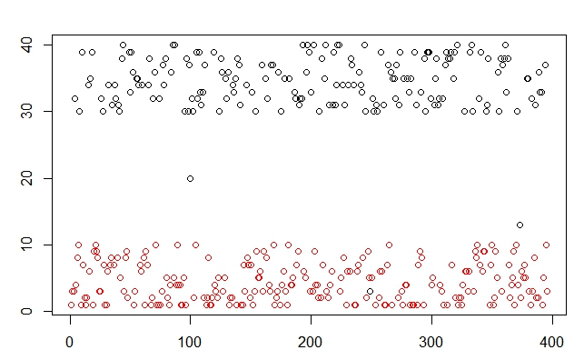
Naïve Bayes
Naïve Bayes classifier is based on Bayes Theorem.
Bayes Theorem : P(A|B) = P(B|A) P(A) / P(B)
Assumes that each predictor is independent and has no influence over other predictors

Slide 21
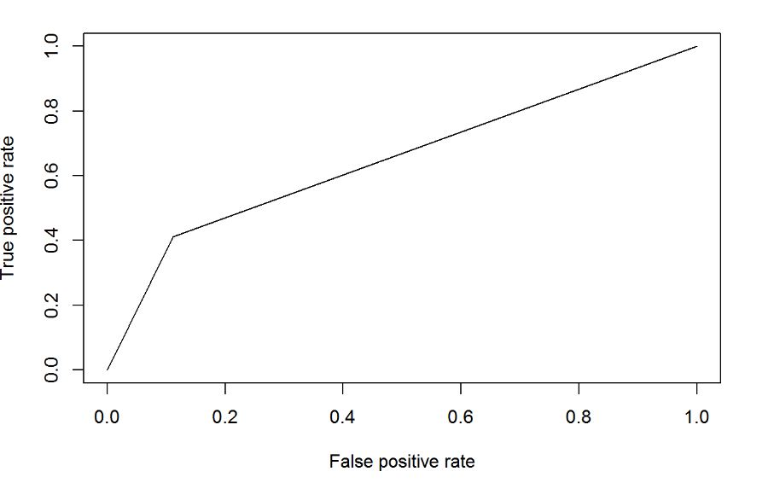
Receiver Operating Characteristics
Plotted based on the confusion matrix
TPR = TP/P ; FPR = FP/N

Slide 22
Conclusion
The successfulness of songs is prediction of the test data sets from songs against the trained datasets by the means of classification method i.e. Supervised Learning by Decision tree, K Nearest Neighbours and Naive Bayes models. The accuracy of decision tree(0.68) is better than the other two models.

